Slide 1
ONLINE AUCTION SYSTEM
INTRODUCTION
DOMAIN: FULL STACK WEB DEVELOPMENT
TEAM NUMBER: TEAM 69
TEAM MEMBERS DETAILS:
1. K MOHAN KUMAR - SM24NS00227
2. K SAI TEJA REDDY - SM24NS00142
3. MALATHESH C - SM24NS00119
4. P RAJIV DIKSHITH - SM24NS00144
PROJECT TITLE: ONLINE AUCTION SYSTEM

Slide 2
ONLINE AUCTION SYSTEM
ABOUT THE PROJECT:
What is the project all about?
This project is an online auction platform called "Bid Now," where users can browse and bid on various products. It features dynamic category navigation, a product slider showcasing the latest items, and category-specific product listings.
Why have you chosen the problem statement?
The problem statement was chosen to address the need for a user-friendly and efficient online auction system, providing a convenient and accessible way for users to participate in auctions, thereby increasing the potential audience and improving the overall auction experience.
Features of the project
Dynamic Category Navigation
Product Slider for Latest Items
Category-Specific Product Listings
Real-Time Bidding and User Authentication

Slide 3
ONLINE AUCTION SYSTEM
Technology Stack:
React.js: The project uses React, a popular JavaScript library for building user interfaces, as indicated by the imports from 'react' and 'react-dom/client' in index.js.
CSS: The project includes CSS for styling, as indicated by the import of index.css in index.js.
HTML: The project includes HTML files for the web pages, as seen in the index.html file
Node.js: The project uses Node.js for package management and scripts, as indicated by the presence of package.json

Slide 4
ONLINE AUCTION SYSTEM
INDIVIDUAL CONTRIBUTION TO THE PROJECT:
TEAM MEMBERS NAME: | CONTRIBUTION
K MOHAN KUMAR | FRONTEND
K SAI TEJA REDDY | BACKEND
MALATHESH C | BACKEND
P RAJIV DIKSHITH | BACKEND

Slide 5
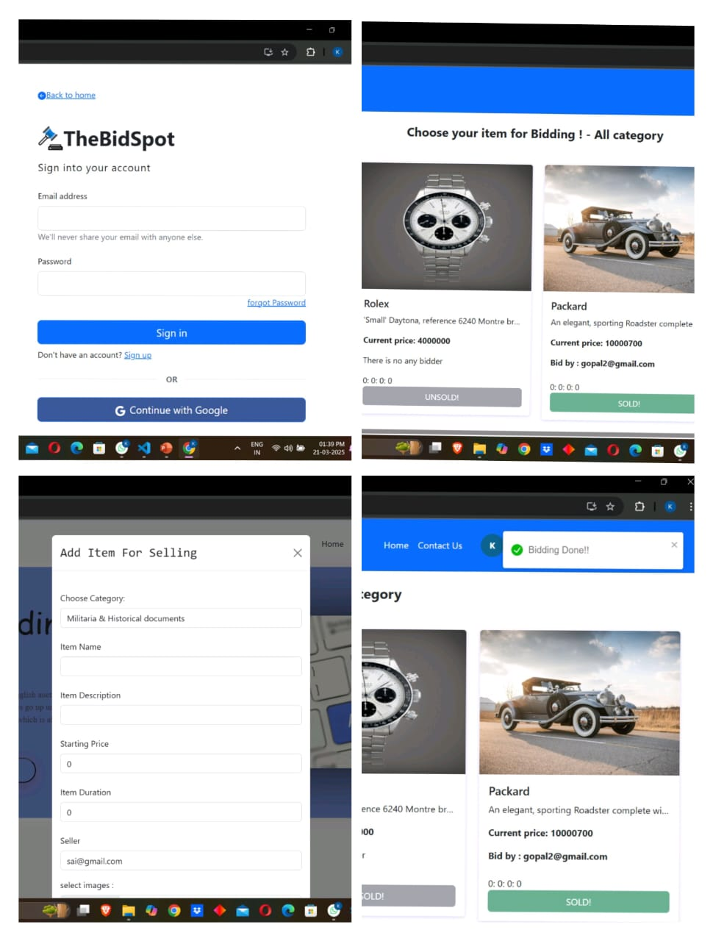
ONLINE AUCTION SYSTEM

